Slide 1
Matter!!!!!

Slide 2
State Standard
SC.8.P.1.a Distinguish between atoms and molecules.
SC.8.P.1.b Describe the difference between pure substances (elements and compounds) and mixtures.
SC.8.P.1.c Describe the movement of particles in solids, liquids, gases, and plasmas states.

Slide 3
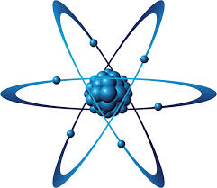
Video Time!!!

Slide 4
Protons…Newtrons….Eclectrons
Let's Build an Element

Slide 5
Element vs. COMPOUND!!

Slide 6
Divide and Conquer
LETS PLAY…..Wait for instructions!!!!

